Slide 1

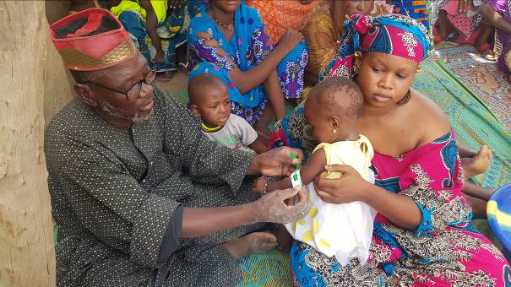
Nutritional Success Stories
February 2020

Slide 2
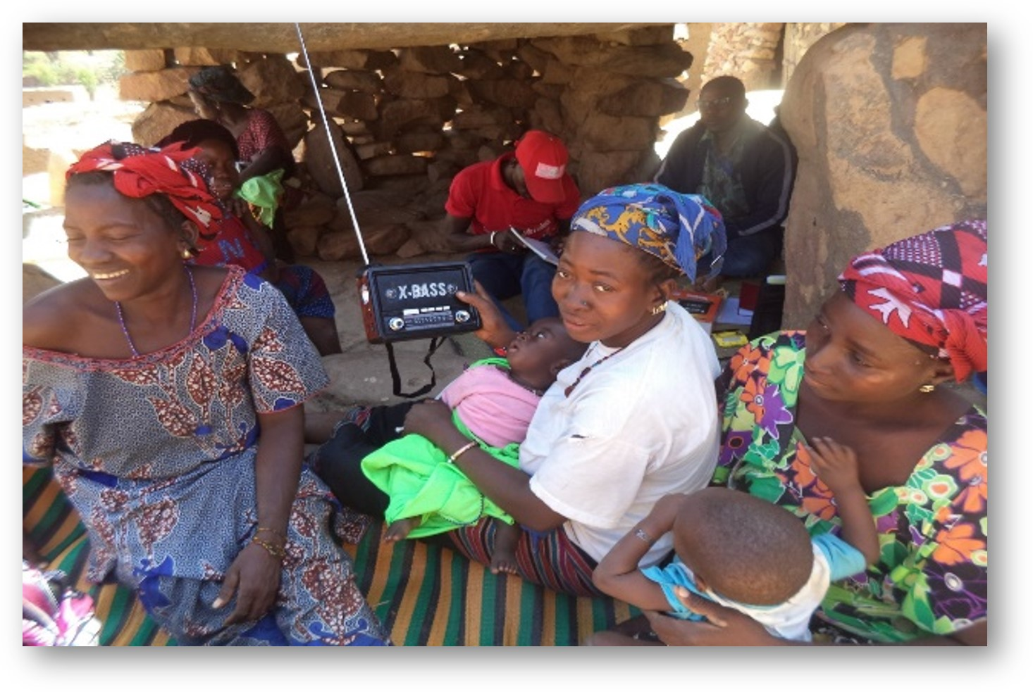

Photo Credit @ Harande, Nutrition Team
Listening group in Adia village, Douentza District, January 2019

Slide 3
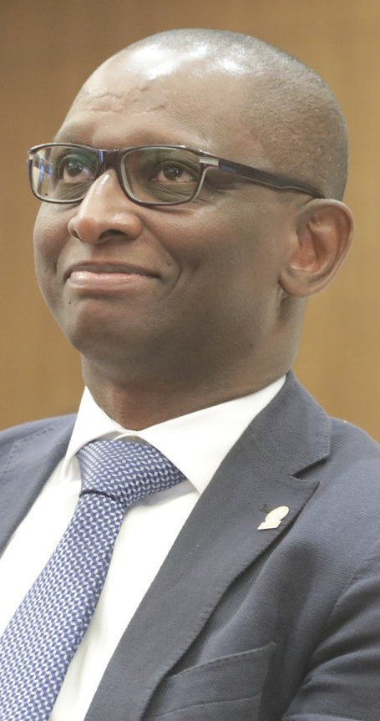
The USAID-funded Harande program (2015-2020) aims to sustainably improve the food, nutrition, and income security of 224,100 members of vulnerable households in the Youwarou, Tenenkou, Bandiagara, and Douentza districts of the Mopti region — an area in central Mali that suffers from frequent drought, conflict and instability.
Harande addresses the root causes of food and nutrition insecurity in 238 villages in 16 municipalities in the four districts.
It is an honor and a privilege for CARE and Consortium partners, Save the Children International (SCI), Helen Keller International (HKI) and national NGOs YAGTU and Sahel Eco, to contribute to such achievement through our established pathways of change.
Balla Moussa SIDIBE, Country Director
CARE International Mali

Slide 4
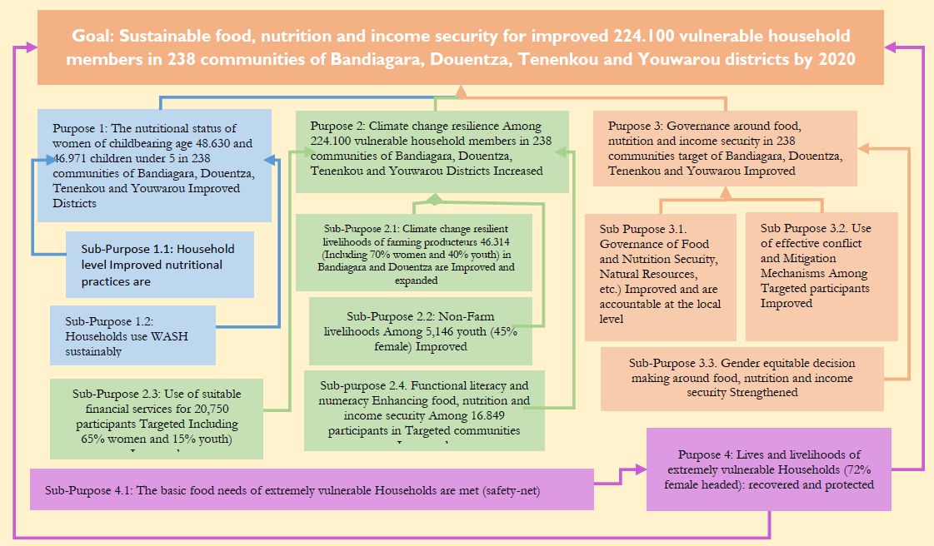
USAID Harande Program: FY18 Theory of Change

Slide 5
Nutritional Pathways of Change
Based on the findings of the Formative Research Study, Harande’s Social and Behavior Communication Change (SBCC) strategy promotes the adoption of key Essential Nutrition Actions & Essential Health Actions (ENA-EHA) and seeks to change social norms that reinforce existing behaviors for women of reproductive age including pregnant and lactating women (PLW), men, and older women within households.
The SBCC strategy also sought to educate participants on the appropriate practice of ENA-EHA and its importance. In order to improve nutritional outcomes for children in the first 1000 days, PLWs received home visits from other mothers who were trained to deliver SBCC messages aimed at improving key nutrition and health practices. These trained Lead Mothers provided on-going support as part of Care Groups led by trained Community Health Workers and Relays.
Harande focuses attention on the first 1000 days of a child’s life and on the health of women in childbearing age from ages 15 to 49 as part of its Purpose 1.
As many adolescents become pregnant and have children, the nutritional status of adolescent girls is important to prevent low birth-weight.
To effectively address these nutrition issues, Purpose 1 is supported by two Sub-Purposes. SP 1.1 is Household Level Nutritional Practices Are Improved, and SP 1.2 is Households Use WASH Services Sustainably.

Slide 6
Care Group Model
Neighborhood Women
Lead Mothers
Promoters
Field Agent
10 pregnant women from the same neighborhood come together and 1 is identified as the Lead Mother
Care Group of pregnant women: 10 Lead Mothers coming from 10 different neighborhoods
Etc..
Etc.
1 field agent supervises on average 6 villages and 12 promoters
10 pregnant women from the same neighborhood come together and 1 is identified as the Lead Mother
Care Group of nursing mothers of children 0-6 months: 10 Lead Mothers coming from 10 different neighborhoods
2 promoters supervise around 30 Lead Mothers in 1 village
Etc.
10 pregnant women from the same neighborhood come together and 1 is identified as the Lead Mother
Care Group of mothers of children 6 - 23 months: 10 Lead Mothers coming from 10 different neighborhoods
Etc.
Etc.
Care Groups are a collection of 10 Lead Mothers led by a promoter to learn ENA-EHA. They are trained to counsel and overcome barriers to change, conduct peer education, and negotiate behavior change. Each Lead Mother is responsible for reaching 10 women, on average.

Slide 7
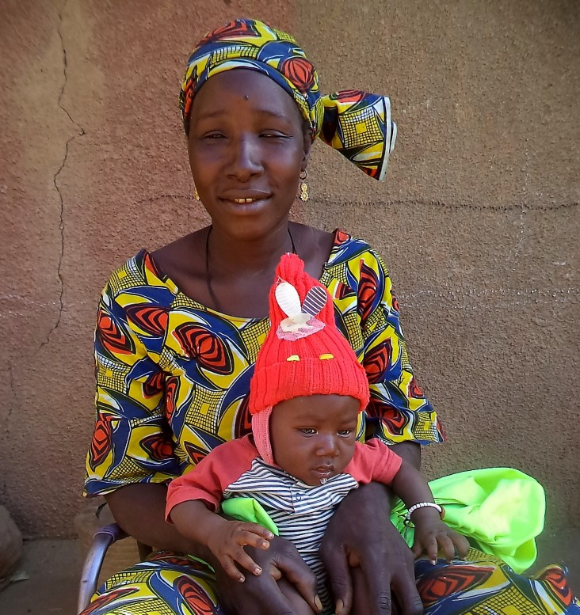
VILLAGE CARE GROUPS HELP PREVENT MALNUTRITION IN RURAL MALI
PLACE
PHOTO HERE.
GO TO VIEW > SLIDE MASTER >
SELECT THIS SHAPE AND THE CARE LOGO >
COPY > GO BACK TO NORMAL VIEW >
PASTE THIS TEMPLATE WHERE YOU WANT >
SHAPE FORMAT > SHAPE FILL >
PICTURE > BROWSE FOR PHOTO >
INSERT > PICTURE FORMAT >
CROP > FILL > ADJUST IMAGE
SIZE AND PLACEMENT >
DELETE THIS TEXT!
“Each month the Care Group met at least two or three times to discuss antenatal care, women's and children’s nutrition, or prepare enriched porridge.
Unfortunately, I continued to feed my child other foods and one day while I was doing so his body became limp.
Today I recommend to all women that they follow the advice given by the Care Group and urge them to carefully listen to the radio broadcasts about exclusive breastfeeding and key nutritious practices for babies and children.”
Photo Credit @ Harande: Awa Maiga with her child, February 8, 2019

Slide 8
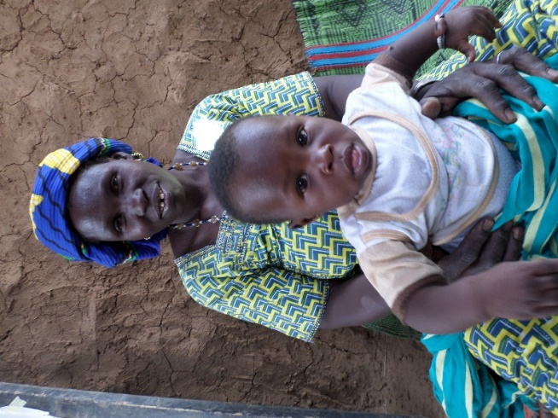
CARE GROUPS:
A Model for Improving Nutritional Practices in Rural Mali
"If malnutrition ended at home and my child is doing very well, as you see, it is really thanks to Harande, because in Dogon, we say:
‘We must not thank the blade that was used to shave your head, but rather the one who cleanly shaved your head without cutting you.’"
Photo Credit: Harande, Monitoring & Evaluation Unit, April 2019

Slide 9
CARE GROUPS:
A Model for Improving Nutritional Practices in Rural Mali
The Story of a Mother
Mariétou Nantoumé is a lactating mother of a 14-month-old boy and four other children in a polygamous household in the village of Wendeguélé in the Bandiagara District. She is not only a member of the VSLA groups but also a Lead Mother in a nursing group of lactating women with children aged 6-23 months.
Before the Harande training on good nutritional practices in Care Groups, Mariétou, like many women in her community, did not practice exclusive breastfeeding or nutritional supplementation from local nutritious products. She was unaware of proper nutritional practices for pregnant and lactating women. Malnutrition was very common among children in her household, and her husband spent a lot of money on health care while also gathering bush leaves to prepare traditional herbal teas.
In addition to her role as a Lead Mother in nutrition, Mariétou participated in several activities, including the sensitization of neighborhood women in nutrition, agricultural knowledge sharing in Farmer Field and Business Schools (FFBS), and water, sanitation, and hygiene (WASH) efforts.
Mariétou is convinced that replication activities will enable her village to become a model of nutrition in the Bandiagara Cercle.

Slide 10
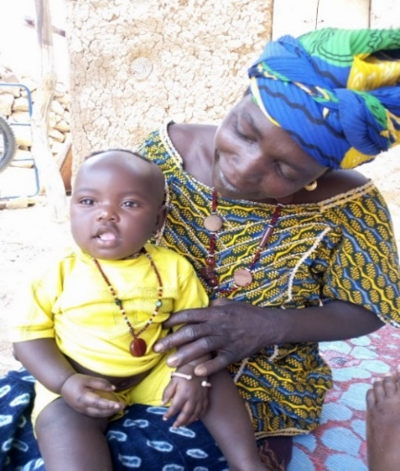
IMPROVEMENT OF THE NUTRITIONAL STATUS of children age 6 to 23 months in the Bandiagara District
The benefits of locally produced enriched flour porridge for Mérèka Kélépily.
“Today, my child has gained weight through the consumption of enriched flour porridge. My daughter goes months without getting sick, unlike before.”
Photo Credit: Harande, Monitoring & Evaluation Unit, April 2019

Slide 11
IMPROVEMENT OF THE NUTRITIONAL STATUS of children aged 6 to 23 months in the Bandiagara District as
The benefits of locally produced enriched flour porridge
Guelemo Kelepily is a farmer in Wendeguélé Village (Bandiagara) who participated in Harande activities on sanitation, hygiene, water treatment, and producing enriched flour. She lives with her husband and seven children (including four girls). Her younger daughter, Mérèka, is only 7 months old.
Previously, she feed Mérèka with Lipton herbal tea and millet porridge. Her daughter was often sick more than 3 times a month. During her illnesses, Guelemo overspent money on drugs. Through the Care Groups, Guelemo learned how to make enriched flour with local products. Now, she prepares and regularly feeds the enriched flour to the little Mérèka.
Without this recipe and the nutritional advice she received in the Care Group, Guelemo said,
"My child would not be healthy as she is today. This result is due to the availability of enriched flour which ensures a normal diet.”
Thanks to nutritional and enriched flour demonstrations, Guelemo is able to prepare porridge made with local products. She is committed to educate the other village women on good nutritional practices learned through the Care Groups.

Slide 12
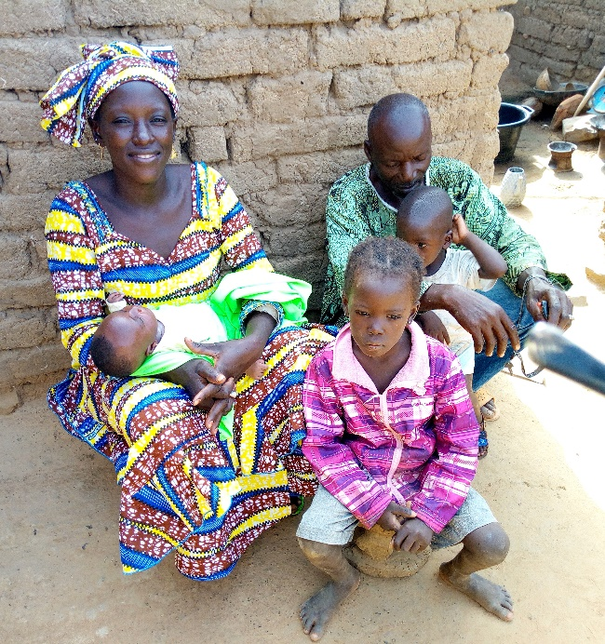
THE POSITIVE IMPACT OF MISOLA FLOUR CONSUMPTION on the Nutritional Status of Pregnant, Lactating Women and Children aged 6 to 23 months
"I have noticed many positive changes after the consumption of Misola flour. It tastes good and strengthens individuals. I observed that children are well nourished because they have satisfactorily changed their fitness as they have gained more weight.”
Photo Credit: CARE Mali, Field Staff

Slide 13
THE POSITIVE IMPACT OF MISOLA FLOUR CONSUMPTION on the Nutritional Status of Pregnant, Lactating Women and Children aged 6 to 23 months
In order to strengthen nutrition for PLWs and children aged 6 to 23 months, the program conducted cooking demonstrations using Misola flour (composed of millet, soybeans, and peanuts) and distributed the flour to communities in Bandiagara and Douentza Districts during Fiscal Year 2017.
Lematou Amsa is 27 years old with 3 children. She was expecting her 4th child in August 2017 when she received her first distribution of Misola flour from the Harande program. As part of the Misola distributions, Lematou received 500 gram rations in her name and her new child’s name.
Since she and her family started eating Misola porridge, Lematou has seen many improvements for herself and her children. She says,
"I see that my children are well nourished because they gained more weight. I have also gotten healthier since I’ve started taking this porridge.”
She adds, "After taking Misola flour, the children have more energy. They show their joy through games, laughter, and a lot of other radiant gestures. They are better able to play on their own."

Slide 14
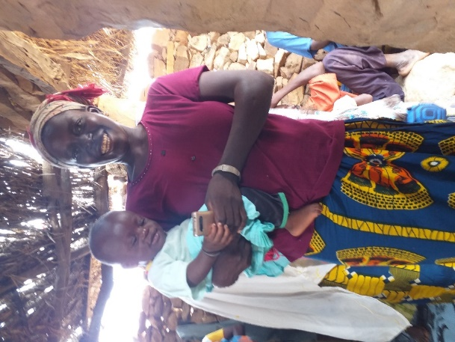
FATOUMATA BANOU, AN EXTRAORDINARY WOMAN
Dagabidé village, Dandoli Commune, Bandiagara
Her last pregnancy coincided with the start of the Harande program in her village. Following the messages broadcasted on the advantages of the antenatal care (ANC) for maternal and child health, Fatoumata carried out four ANC visits.
"I have received very good communication from the Harande program on the health of women and children. I am passing on this knowledge to other women in the village. Women trust me, because all that I recommend to them as a good practice, I do it myself first."
Photo Credit: Nutrition Team, 2019

Slide 15
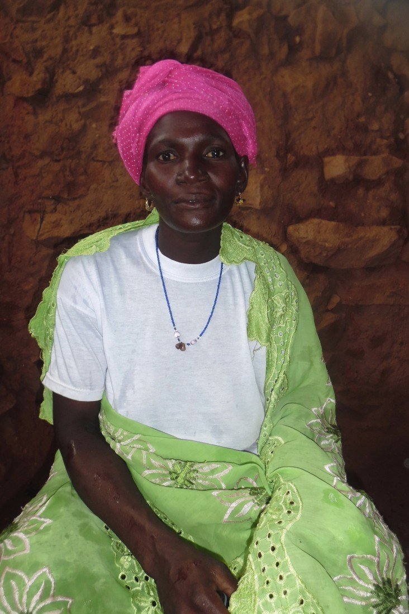
ANTENATAL CARE BOOSTS HEATLH OUTCOMES
Sincarma Village, Dandoli Commune, Mopti Region
PLACE
PHOTO HERE.
GO TO VIEW > SLIDE MASTER >
SELECT THIS SHAPE AND THE CARE LOGO >
COPY > GO BACK TO NORMAL VIEW >
PASTE THIS TEMPLATE WHERE YOU WANT >
SHAPE FORMAT > SHAPE FILL >
PICTURE > BROWSE FOR PHOTO >
INSERT > PICTURE FORMAT >
CROP > FILL > ADJUST IMAGE
SIZE AND PLACEMENT >
DELETE THIS TEXT!
“I regularly take part in the educational discussions of Harande because we meet with women to discuss good practices to adopt during pregnancy and after childbirth. Since I have started performing antenatal care, I am no longer suffering from abnormalities as was the case with my previous pregnancies.
The ailments I suffered—such as malaria and abdominal pain—were treated by the health worker. I am in my seventh month of pregnancy and have already completed three antenatal care visits to the health center. Even after the phase out of the Harande Project, I will continue to visit the health center.“
Photo Credit @ Harande: Fatoumata Ouloguem

Slide 16
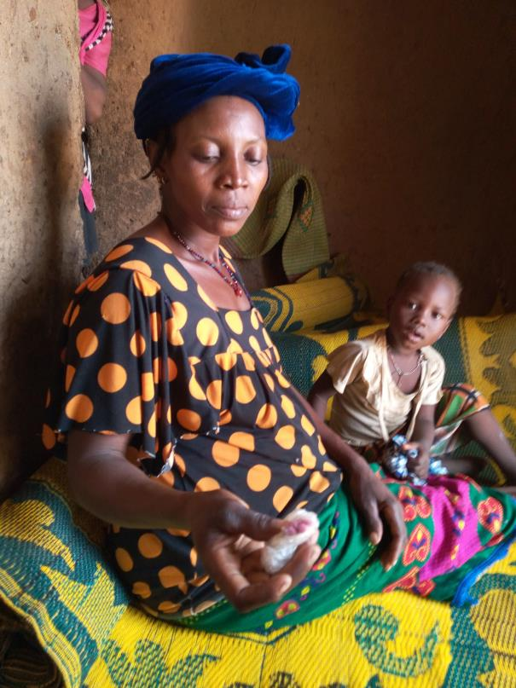
ACCESS TO MATERNAL AND CHILD HEALTH AND NUTRITION INFORMATION THROUGH CARE GROUPS
“ I feel less tired than before, and I feel good about myself. Now I ask all women to go for prenatal care at the beginning of their pregnancy and to follow the advice of the health agent and take the medicines they receive.”
Photo Credit: Nutrition Component 2019

Slide 17
ACCESS TO MATERNAL AND CHILD HEALTH AND NUTRITION INFORMATION THROUGH CARE GROUPS
Who has good health has good wealth
Harande has put maternal, infant, and child health at the center of its strategy, using a combination of approaches for social and behavior change including Care Groups, radio programs, community conversations, and community theater. Together, these channels contribute to new understanding and adoption by community members. Djeneba Kougoulba’s story is just one example but has made her a respected expert in her community.
When the Harande program arrived in her village and introduced the Care Group, Djeneba joined immediately and regularly attended the meetings. She paid close attention and remembered the messages about nutrition and health practices, including the importance of four antenatal care exams during pregnancy. So, as soon as she realized she was pregnant, she made her first visit to the health center.
“When I learned I was pregnant, this time I went to the health center. The health agent prescribed medicine, gave me advice about my diet, the benefits of iron-folic acid supplements, etc. In fact, I had already heard these ideas from my Care Group.”

Slide 18
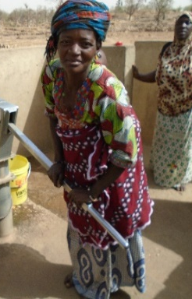
LIVING CONDITIONS IMPROVE IN RURAL COMMUNITIES
A sigh of relief for the women of the Sassadi Village
“The most significant change following the intervention of the Harande program in the village of Sassadi is the realization of access to water.
Our village has water through the realization of a village system and the repair of the human motor pump (PMH) by Harande, which has alleviated our suffering, as women, not only related to searching for water but also to diseases such as diarrhea.”
Photo Credit: Harande, Monitoring & Evaluation Unit, April 2019

Slide 19
LIVING CONDITIONS IMPROVE IN RURAL COMMUNITIES
A sigh of relief for the women of the Sassadi Village
Mède and several women from the village participated in Harande’s activities, including: (1) implementation of an improved village water system integrating the garden perimeter; (2) rehabilitation of the human motor pump; (3) establishment of water, hygiene and sanitation committees; (4) establishment of Care Groups; (5) preparation of the enriched flour porridge; (6) construction of bunds through the cash for work approach; (7) thematic training in WASH, and functional literacy training in Dogosso; and (8) gender-specific interventions.
"Before, women like me faced several problems. We draw water from the only well in the village which is poorly maintained since access to drinking water is not easy with financial concerns. We are surrounded by 7 villages where we go to seek water. There, we encounter a lot of forms of verbal abuse. The nearest village is 2.5 km away and the farthest is 4 km away. When we do not find water in one of the nearest, we must first return to our village before taking the path for the other village.”

Slide 20
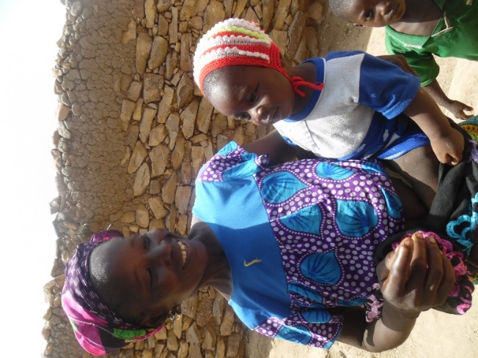
CARE GROUPS:
Preventing Malnutrition through Exclusive Breastfeeding
"I fed my second child only breastmilk for the first 6 months without giving him water or any other traditional food. From birth until now he rarely gets sick, cries less and plays happily.”
Harande uses the Care Group approach to connect PLWs with other mothers of children under 2. Sessions are organized to demonstrate best nutritional approaches.
Photo Credit: Harouna Tembely 2018

Slide 21
CARE GROUPS:
Preventing Malnutrition through Exclusive Breastfeeding
Care Groups are formed for expecting and lactating mothers to come together and learn from each other’s experience. Facilitated discussions around nutrition thematic areas are organized with support from lead mothers to promote positive nutritional behaviors. These different approaches lead to the adoption of good nutritional practices by the community members, including Aminata Djiguiba.
Aminata Djiguiba, a 28-year old woman with two children, is member of the Care Group in Wolo Wolo village in the Dandoli commune, Bandiagara District in Mopti Region. Aminata did not practice exclusive breastfeeding for her first child but after participating in the local Care Group, listening to the advice of other mothers in the group, and hearing about exclusive breastfeeding on the radio, she decided to adopt exclusive breastfeeding for her second child.

Slide 22
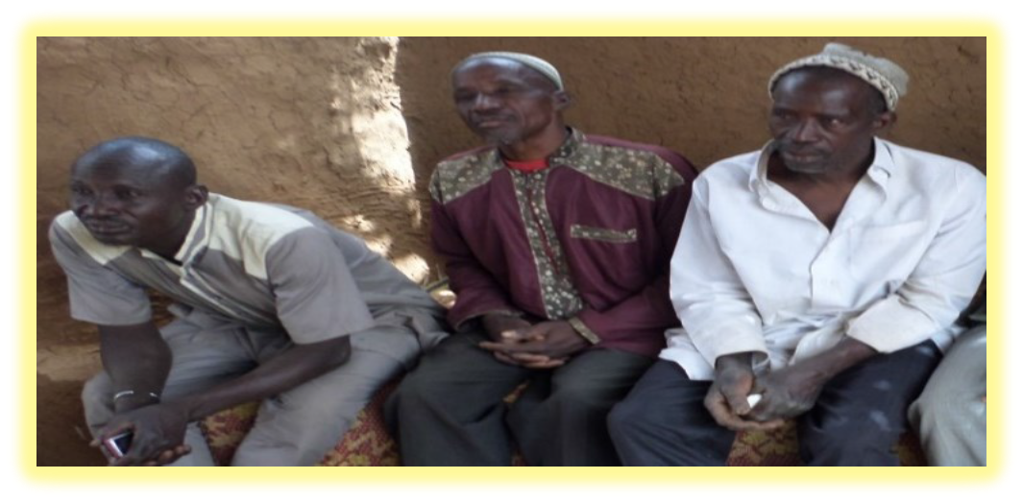
ENRICHED PORRIDGE WITH LOCAL PRODUCTS & MICRONUTRIENTS:
Men Report Benefits
"I did not know that good nutrition for children was a major factor in avoiding disease. Thanks to Harande, we know how to make enriched porridge with the use of drinking water. I would have fewer health problems and fewer expenses related to child health. Since my children began to consume enriched porridge, I see an improvement in their health. There was the reduction of diseases and I can save money for other expenses."
Photo Credit: Harouna Tembely 2018

Slide 23
ENRICHED PORRIDGE WITH LOCAL PRODUCTS & MICRONUTRIENTS: Men Report Benefits
Dogolou Kelepily is a married 54 year old village agent promoting health/nutrition in the Wendeguelé village in the Bandiagara district. The village has benefited from a mill, a village water system, and other activities related to agricultural production using improved technologies.
He describes the health situation before the Care Groups were established by Harande: "Before, the children were very sick. There was no difference between feeding children and adults. We spent a lot of money on drugs and we did not often have money to deal with it. "
Harande has worked with the Care Groups to manufacture flour porridge enriched with local products.
"I participated with Harande in the establishment of Care Groups in the village, the fight against malnutrition in families and children, training on the construction of latrines, and the preparation of the enriched porridge.”
These activities have led to tremendous changes in his family and community, particularly for children's health.

Slide 24
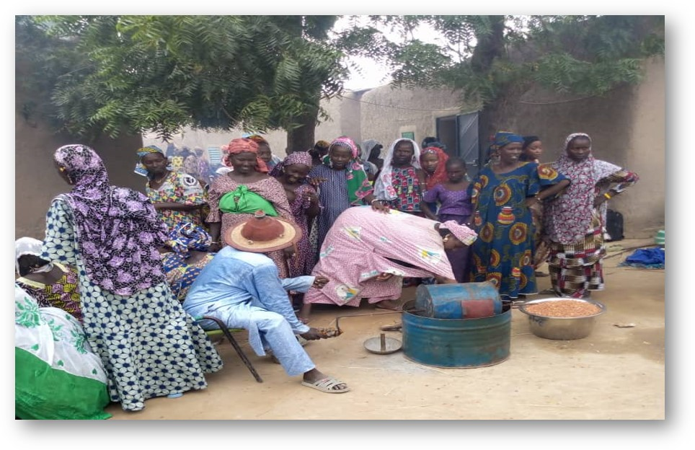
Photo Credit @ Harande, Nutrition Team: Enriched Flour Production in the village of Konafabé-Sougoulbé, Tenenkou cercle

Slide 25
Technical Partners:
CARE Mali is the lead of the consortium and accountable for overall program coordination and accomplishment of all targets. CARE’s role also extends into financial management; management of vouchers and cash transfers; monitoring, evaluation and learning; sub-recipient management; compliance with donor procedures and U.S. Government regulations; maintenance of the relationships with USAID/FFP. CARE is the technical lead for Purpose 2: Climate Change Resilience and Livelihoods; Purpose 3: Conflict Prevention, Governance and Gender, Purpose 4: Early Recovery and Emergency activities. CARE also leads WASH interventions of Purpose 1: Human Capital. CARE provides leadership in ensuring that gender equity considerations are integrated into all aspects of the program.
Helen Keller International Mali serves as the overall technical lead for Purpose 1: Human Capital and Nutrition, where they are responsible for the technical quality control of all integrated nutrition, Maternal and Child Health, and Family Planning/Reproductive Health interventions. HKI leverages its strength in Social and Behavior Change as well as facilitate adoption of practices that enhance participants’ nutrition, livelihoods, and resilient adaptation to changing conditions.
Save the Children Mali leads the education (literacy and numeracy) and the youth entrepreneurship component of Purpose 2: Climate Change Resilience and Livelihoods.
Implementing Partners:
YA-G-TU implements all activities in Bandiagara District.
Sahel-Eco implements all activities in Douentza District.
Other Partners:
Nyeta Conseils facilitates farmers’ harvest warrantage, link with MFIs and market related activities with value chains actors.
ILRI helps in implementing livestock management and poultry related activities.
ICRAF and ICRISAT are working on watersheds as well as wide spreading innovative agriculture production techniques.
IER facilitates activities in Farmers Fields and Business Schools.
Government Technical Services (Agriculture, Health, Livestock and Animal Production, Rural Engineering, Pollutions and Nuisances, etc.) as well as Local Authorities guide and monitor implementation of all activities related to their respective sectors and areas.
Contact: CARE International Mali
Idriss Leko, Chief of Party
Idriss.Leko@care.org

