Slide 1


For 70 Years,
Delivering Lasting Change
Notes:
Talking Points/Additional Information:
You’re probably somewhat familiar with CARE. Nearly everyone has sent and received “care” packages, but you may not realize that CARE sent the original CARE Package in 1945, launching what would become a global poverty-fighting organization working in 90 countries. This presentation will shed some light on the evolution of CARE, by delving into the when, what, where and how of the organization.

Slide 2
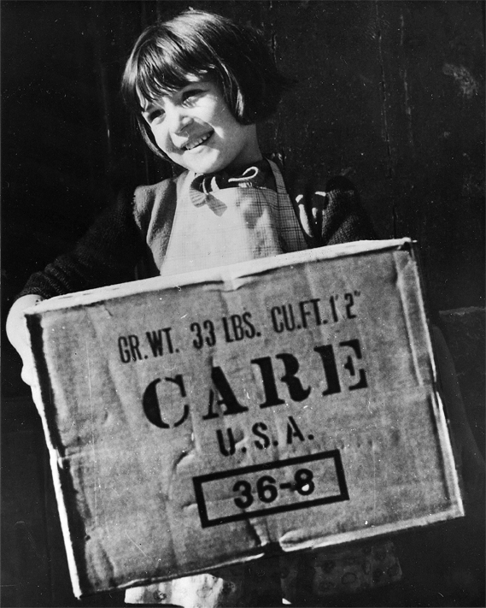
The CARE Package Then…
CARE was founded in 1945 as a means
of rushing lifesaving food and supplies
to World War II survivors.
The first CARE Package® arrived in
Le Havre, France, on May 11, 1946
The first CARE package was among the 100 million CARE Packages delivered to people throughout Europe — revealing the power of a box to change the world
“Every CARE Package . . . expresses America’s concern
and friendship in a language all peoples understand.”
President John F. Kennedy, 1962
Notes:
Talking Points/Additional Information:
CARE has a long history of reaching out to people in need. The organization was founded 70 years ago to bring help to a world devastated by war. The first CARE Package arrived in France on May 11, 1946, containing items such as dried meat, canned milk, raisins and chocolate.
In the months that followed, more than 100 million CARE packages were shipped overseas in that post-war initiative, with 22 different organizations sharing their money and energy to support the effort. As Americans reached out to help, they reached into their hearts to embrace a new model of charitable giving – sending their generosity to strangers they would likely never meet, living in places they would probably never see.
Over the years, the CARE package has become a lasting symbol of compassion and generosity. And, as President Kennedy said, it speaks, eloquently, in a language that everyone understands.

Slide 3
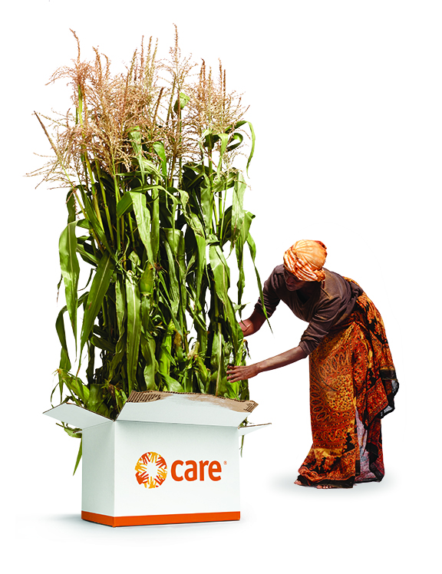
…The CARE Package of Today
The CARE Package of today aims to cut poverty at its roots –
by bringing tools for sustainable change to the people most vulnerable to hunger, intolerance and disease by creating hundreds of long-term projects serving millions of people each year.
CARE facilitates lasting change by:
Strengthening self-help capacity
Expanding economic opportunity
Providing emergency relief
Influencing policy decisions at all levels
Fighting discrimination in all its forms
Notes:
Talking Points/Additional Information:
CARE has evolved into an organization with a broad range of programs that reach millions of the poorest individuals in the poorest communities around the world. Instead of just delivering aid, today CARE is focused on delivering lasting change.
CARE’s hundreds of projects do more than offer temporary support and benefits. Through its long-term poverty-fighting programs, CARE helps to strengthen people’s capacity for self-help through tools and education . . . by providing economic opportunity in the form community savings and loan associations . . . delivering relief in emergency situations caused by natural disasters and the ravages of war . . . Influencing policy decisions at all levels of government, nationally and in international bodies . . . and by addressing discrimination in all its forms due to race, gender and other forms of prejudice.
The CARE package is working to cut poverty at its roots – with tools that help the world’s poorest communities create sustainable change . . . and lift each other from the grip of hunger, intolerance and disease.

Slide 4

Women and Girls: At the heart of CARE’s work
CARE helps to ensure that women
and girls are empowered through…
Education
Economic opportunity
Ability to make choices on their own
. . . enabling them to become
catalysts for lasting change.
Notes:
Talking Points/Additional Information:
A focus on women and girls lies at the heart of CARE’s work – for this compelling reason: The lack of control that women and girls have over their lives is one of the root causes of poverty.
When a woman is empowered through education, economic opportunity or the ability to make choices on her own, she can be a catalyst for lasting change. In fact, equipped with the resources they need to succeed, women and girls can lead themselves, their families and entire communities out of poverty.
CARE has seen it again and again, all over the world. Today you’ll see just a few snapshots of the many transformations that are taking place.

Slide 5
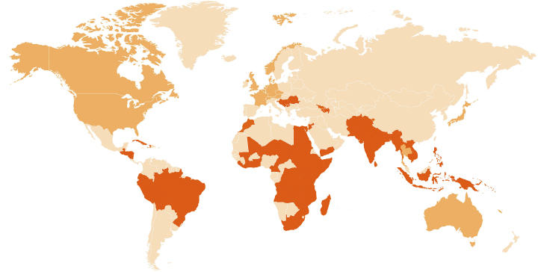
Where CARE works
72+
MILLION PEOPLE REACHED
880
POVERTY-FIGHTING PROJECTS
90
COUNTRIES
Notes:
Talking Points/Additional Information:
CARE is a leading humanitarian organization working in 90 countries, supporting 880 poverty-fighting development and humanitarian aid projects to reach more than 72 million people. Numbers reflect fiscal year 2014.

Slide 6



How CARE is transforming lives
CARE’s poverty-fighting programs deliver
immediate resources and lasting change in these key areas:
Sexual Reproductive Health
Women’s Economic Empowerment
Humanitarian Action
Food and Nutrition Security
CARE seeks a world of hope, tolerance and social justice,
where poverty has been overcome and people live in dignity and security.
Notes:
The breadth and depth of CARE’s work are both impressive and effective. To achieve maximum, sustained impact, CARE is active in these key areas:
Sexual Reproductive Health, which helps women strengthen their maternal well-being and to live a life free of violence.
Assuring that women have better access to financial and economic resources, which can reduce problems that have afflicted families for generations
Humanitarian efforts that bring people life-saving assistance in crisis situations.
Food and nutrition security, which keeps families healthy, allowing them not only to survive but to thrive.
We’ll look at each of these areas through the eyes of people who are delivering and experiencing CARE’s help.

Slide 7
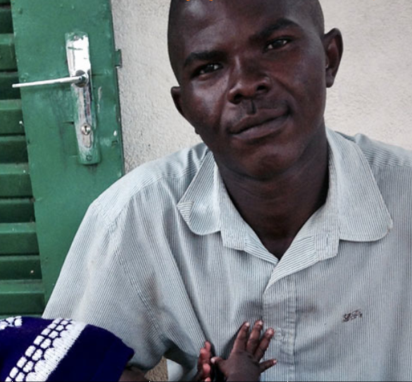
Improving sexual reproductive health
MEET Dr. Jimmy Nzau
A physician and project director with CARE in Chad
BRIDGING
THE FAMILY PLANNING
DIVIDE
“If you invite men and boys to the discussion, the path to the world we want to create just gets that much shorter.”
Notes:
Talking Points/Additional Information:
Every 90 seconds, a woman dies from complications during pregnancy or childbirth. CARE works to reverse those statistics in many of the poorest areas on earth.
In Chad, where women have an average of 6.7 babies, Dr. Jimmy Nzau led a CARE program to improve their access to family planning. After getting buy-in from religious leaders, he supplied clinics with provider training, equipment and medicines, within 60 days family planning patients grew from 100 to 1100 a month. Then the police came to warn it’s illegal to dispense contraceptives without a husband’s approval.
Dr. Nzau made the officers aware – for the first time – about a 2002 law guaranteeing any woman’s right to contraceptives, regardless of spousal consent. The officers were pleased to learn about the CARE program, and later came to a two-day workshop Dr. Nzau facilitated. Police and military groups even committed to act as counselors or conflict negotiators for couples who disagree about family planning. The interest of men and boys is a powerful by-product of CARE’s work to empower women and girls.
Additional presentation tool about CARE’s work in Family Planning: https://www.youtube.com/watch?v=fKFZuRHaX2o
sources:
http://www.care.org/work/health/maternal-health
http://saportareport.com/leadership/globalhealth/2014/11/10/family-planning-in-chad/

Slide 8
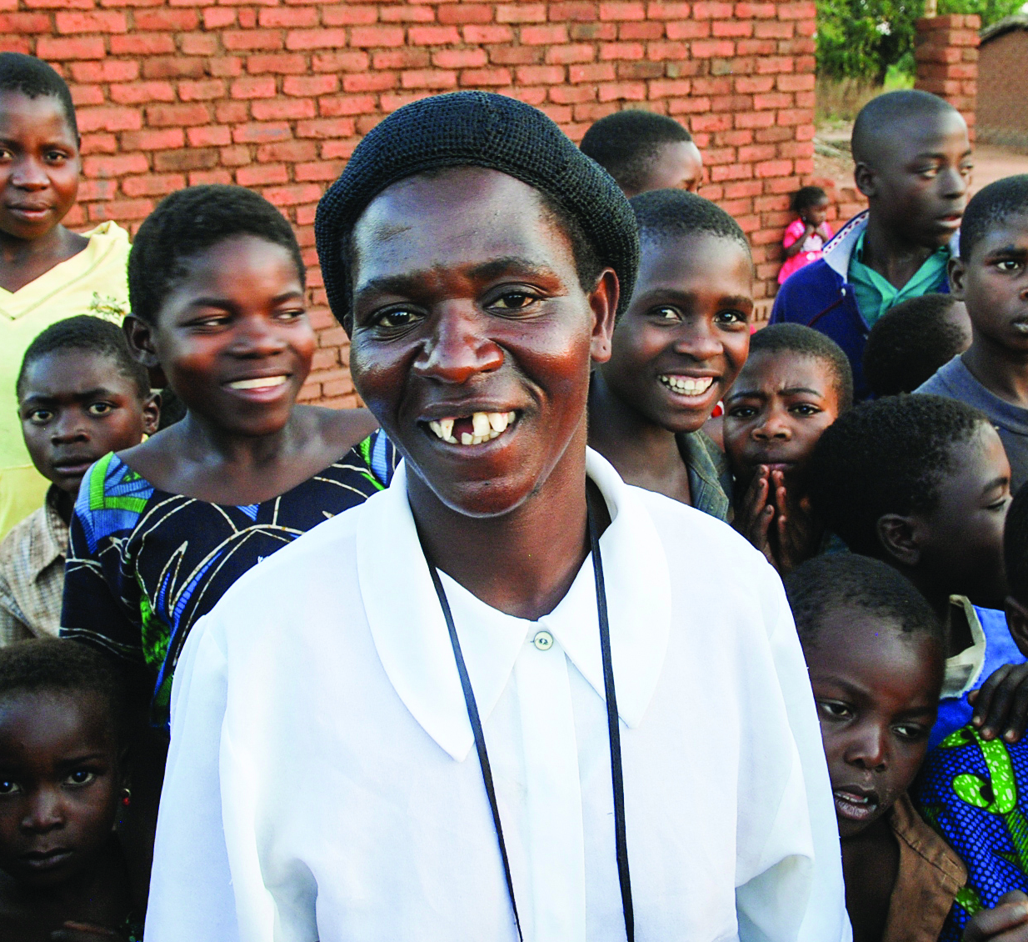
Igniting women’s economic empowerment
MEET Biti Rose
A CARE project participant in Malawi
DOUGHNUTS:
A RECIPE
FOR SUCCESS
“I think even my children
will go to school because
of this success.”
Notes:
Talking Points/Additional Information:
Biti Rose Nasani and her husband Alfred had long lived under the grip of poverty in their Malawi village of Masumba. They had to pull their son out of fourth grade because they couldn’t afford the five dollars a term it cost to send him to school. They farmed only a portion of their two-and-a half acre plot because there was no money for seed.
Then something happened to change Biti Rose’s life. CARE introduced the Village Savings and Loan Association to the women of Masumba. Each week Biti Rose and about 20 others would meet to deposit 10 cents each in the VSLA lock box. At one point, Biti Rose took out a $2 loan and used it to make doughnuts, which she sold for two cents apiece.
She’s defeating poverty with a $2 loan and 2-cent doughnuts.
Soon she was pocketing several dollars a day in profits and Alfred began growing and selling vegetables. Their incomes allowed the Nasonis to buy fertilizer. Now they hire 10 people to work the land they own or lease. Instead of the single bag of corn they used to harvest, the Nasonis fill seven oxcarts with their bounty. And Biti Rose plans on using the proceeds to send her younger children to university.

Slide 9
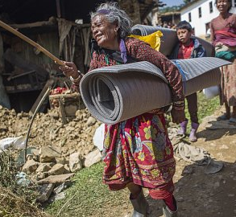
Responding to crises with humanitarian action
MEET Thuli Lama
One the 50,000 people injured in the Nepal earthquake
HEAR
THE NEED
FOR HOPE
There are 45.2 million refugees and displaced people worldwide. That’s a staggering number of people struggling for daily survival.
Notes:
Talking Points/Additional Information:
When Nepal’s devastating earthquake jolted Thuli Lama to the ground, she struggled to stand up – and barely escaped before her house collapsed. At 72, she was unable to walk the long distance to receive relief materials the government handed out. She’d been sleeping on the ground before CARE arrived with mattresses, rice, noodles and water purifiers.
CARE rushes to crisis situations all over the world. Last year CARE responded to the needs of 12,000,000 people left homeless by acts of nature or violent forces of war. With nothing but the clothes they are wearing, many spend months, and even years, waiting for an end to their misery. In so many places, CARE is there offering supplies, support and hope.

Slide 10
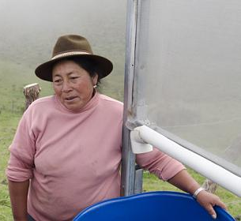
Showing the way to food and nutrition security
MEET Maria
A CARE project participant in Ecuador
CONQUERING
THE EFFECTS
OF CLIMATE
CHANGE
“I don’t have an education. But thanks to the engineers who came, we’ve become much more aware of agriculture.”
Notes:
Talking Points/Additional Information:
In the highlands of Ecuador, where women are the traditional farmers, Maria and her neighbors were facing severe hardships caused by climate change. Unpredictable frosts and harsh winds were robbing them of nutritious food and security. Fruits and vegetables that had thrived for centuries were producing very little. And because of the short growing season – only three months – they were facing shortages during the leanest times of the year. Desperately poor, families moved to the city for work, but were living off charity.
Fortunately, CARE has responded to the plight of Maria and her village, with ingenuity and education. CARE technicians taught the women how to grow organic plants and enrich their soil through composting and organic fertilizer. Using simple instructions and supplies, the farmers built greenhouses to produce year-round harvests. In the fields, the CARE teams explained how planting fences of trees could improve temperatures and generate better growing conditions.
Another great innovation is a construction made with PVC pipes and screen. It lets the women turn the nightly mountain mists into precious supplies of water. CARE also assisted the women to take on leadership roles in the community. Now they’re improving their families’ nutrition, contributing to their economic well-being and educating their children. CARE is helping the area’s families, as well as their farms, to thrive.
On CARE’s website, you’ll find many more stories and videos that will give you an idea of the profound difference CARE is making as it works to deliver lasting change.

Slide 11


Where to learn more
“CARE is a fantastic way to do something about poverty and many other issues going on around the globe!”
5-Star CARE Fan on Facebook
Facebook: www.facebook/carefans
Twitter: twitter.com/care
Pinterest: www.pinterest.com/careorg/
Instagram: instagram.com/careorg/
Notes:
Talking Points/Additional Information:
Find CARE on social media and get in on the conversation. You can join people all over the world who support CARE . . . meet members of the CARE team . . . and get a glimpse of the people whose lives, families and even entire communities are being transformed -- through knowledge, tools and the compassion of others.
When you add your likes, you play an active role in generating awareness among your friends and family.

Slide 12

How YOU can help fight global poverty today!
DONATE to CARE today at http://www.care.org/teamcare
JOIN my Crowdrise team at (customizable field)
and help me reach my goal to donate to CARE’s fight to end global poverty.
HOST your own #TeamCARE event– it’s simple to do and the site will guide you through it in practically no time: http://www.care.org/get-involved/care-volunteer-event-toolkit
BECOME a CARE Advocate by joining the CARE Action Network: http://www.care.org/get-involved/advocacy/care-action-network
To learn more about CARE, visit www.care.org
Notes:
Talking Points/Additional Information:
Here are several ways to participate in CARE’s fight against global poverty. Just being here is a great start.
If you’d like to do more, I encourage you to make a donation, in any amount that works for you.
(option 1) Want to help CARE end global poverty? Donate to the #TeamCARE page today.
(Option 2) If you learned a lot from the event, join my page on CrowdRise. I’d welcome your help in reaching my goal for CARE. You can go to (website address) if you’d like to make a donation in that way.
(Option 3) You can also start your own fundraiser on CrowdRise, and receive step-by-step event help by signing up for your own event on the #TeamCARE Volunteer Event Toolkit page – it’s simple to do and the site will guide your through it in practically no time.
(Option 4) You can also support CARE’s mission by becoming an advocate for lasting change and speaking out about issues such as child marriage, violence and intolerance, refugees in crisis, access to education and more. Join the CARE Action Network, a group of supporters who are working to urge our nation's leaders to support global poverty issues. For example, CARE makes policy recommendations to help ensure our government’s foreign assistance programs are really devoted to positive change, not expensive band-aids. As part of the CARE Action Network you can lend your voice and communicate with officials in a meaningful way.
To learn even more about CARE and their work, visit www.CARE.org

Slide 13

Thank You!
“Overcoming poverty is not a gesture of charity. It is an act of justice.”
-Nelson Mandela
Notes:
Talking Points/Additional Information:
As Nelson Mandela has said, overcoming poverty is not a gesture of charity. It is an act of justice.”
Again, thank you for your interest and for being here (today) (tonight). Do you have any questions?

