Slide 1
Telling Your Digital Story
Kiera Stein
Web Content and Social Media Manager, CARE
@KieraStein
@CARE

Slide 2
What’s the big deal about social media anyway?
Social media is the #1 activity on the web
68% of people will learn more about a charity if they see a friend posting about it on social media
- 39% would donate to the charity
23% of Facebook users check their account five or more times every day
25% of smart phone owners ages 18-44 can’t recall the last time their phone wasn’t at their side

Slide 3

Telling Your Digital Story on Social Media
Define your social media persona
Who do you want to be on social media and how do you want to be perceived?
What will you talk about? What do you hope to accomplish?
This is Sally. Sally attended the 2014 CARE Conference and was inspired by stories of violence against women. She’s decided to use social media to raise awareness around this issue and connect with like-minded people.

Slide 4
Telling Your Digital Story on Social Media
What can you bring to the table?
Why do you feel connected to this issue?
Why are you uniquely positioned to talk about it? (this does NOT mean you have to be an expert)
What do you want to accomplish?
Sally volunteers once a week at a shelter for battered women. After learning about women with similar stories in developing countries at the CARE Conference, she decided she wants to connect the experience of survivors in the U.S. to those abroad.

Slide 5

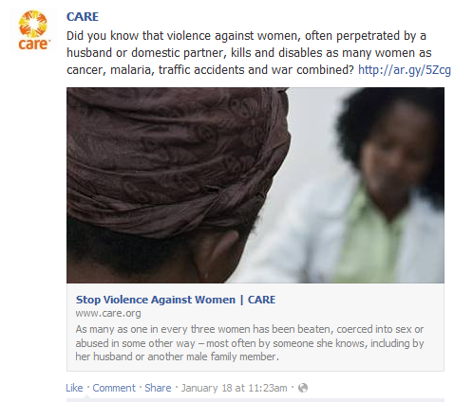
Telling Your Digital Story on Social Media
Find the conversation – then join it!
Where are people talking about your issue?
Hint: Start on Facebook and Twitter. Look for hashtags, Twitter chats, organization accounts and public figures.
Sally commented on CARE’s Facebook post about violence against women. Another supporter responded to her comment with some insightful information. Now the two are friends on Facebook and exchange resources on the issue regularly.

Slide 6
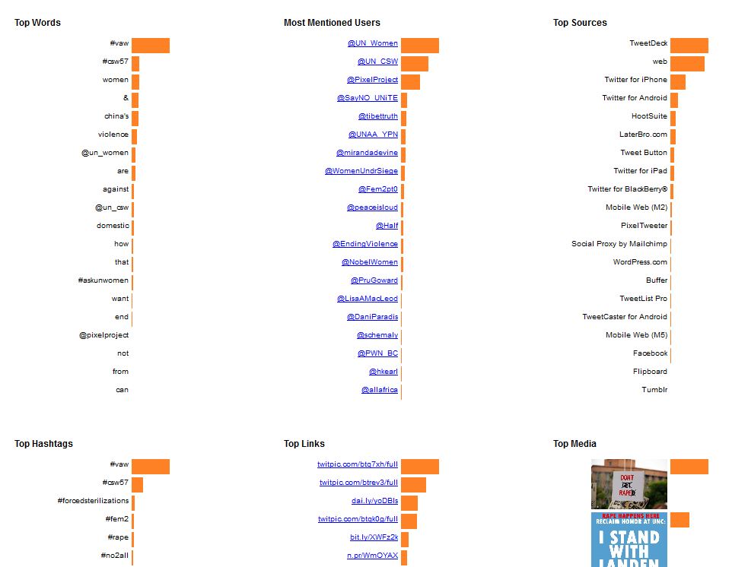
Telling Your Digital Story on Social Media
Tweetcharts.com

Slide 7
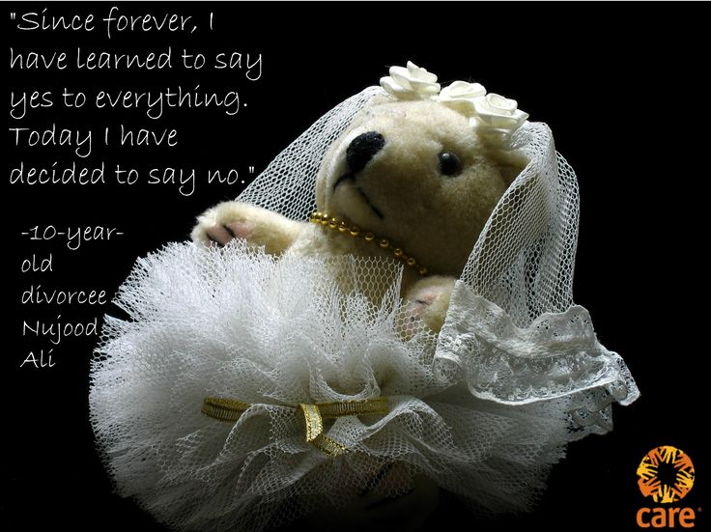

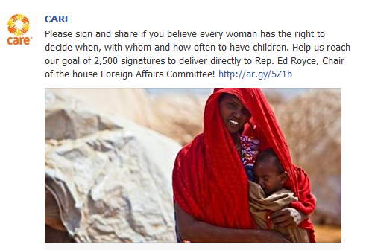
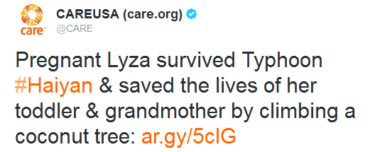
Telling Your Digital Story on Social Media
Tell your story – but make it snackable
Make your content visual
  Use Picmonkey.com to overlay images with text
  Use Piktochart to create infographics quickly
  Use Storify to aggregate content
Make your point – then link to more
  Compelling statistic
  Inspiring quote
  Tease a story
  Call for action
Notes:
People on social media like to digest content in different ways. A good social media post makes you want to do more, elicits an emotion. Guess what? The MTV generation grew up, and they invented Facebook. They want the headline – not the story. Think of it as a marketplace. The best headline wins the reader. Also, every social post has its own goal. Read more, engage, take an action offline or elsewhere on the web.

Slide 8
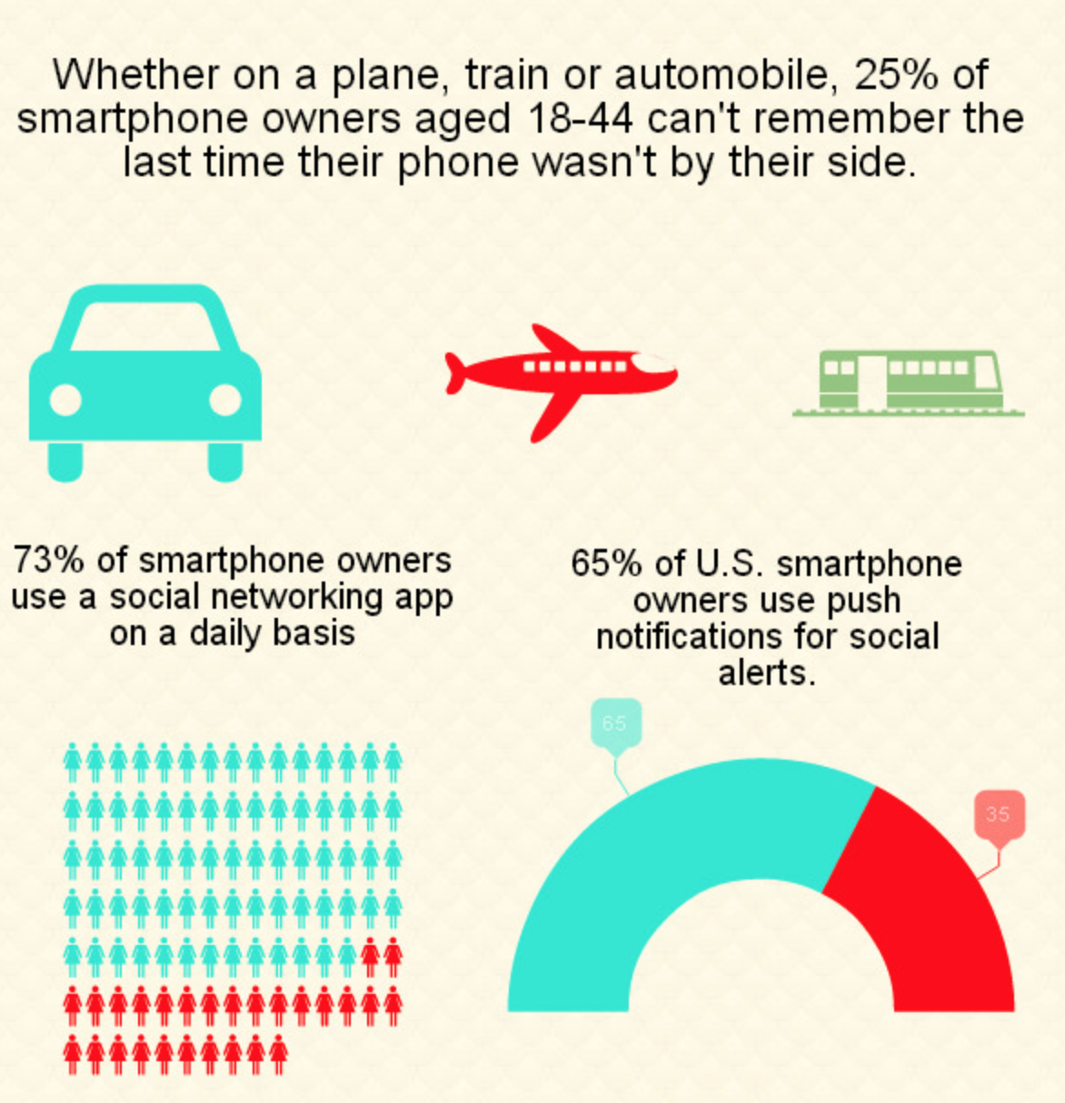
Telling Your Digital Story on Social Media
Piktochart.com

Slide 9
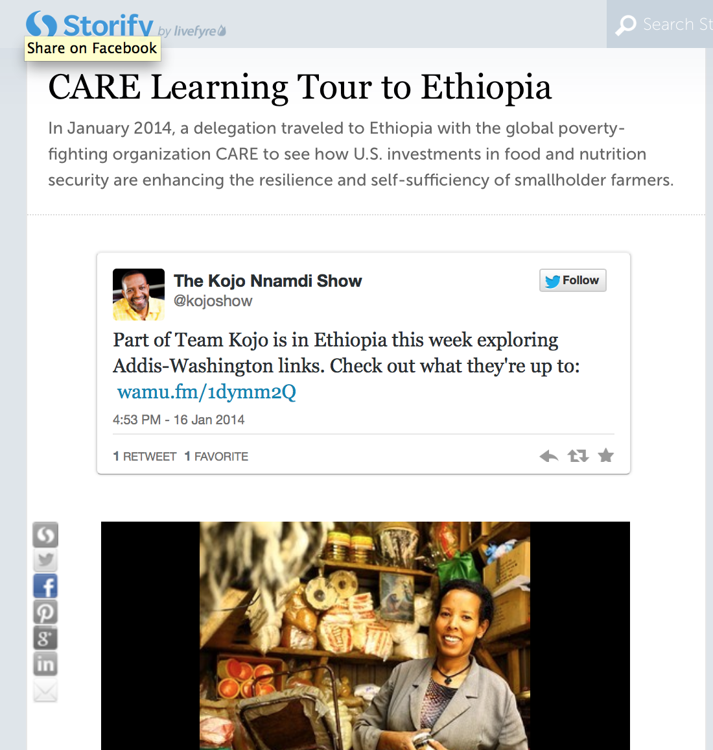
Telling Your Digital Story on Social Media
Storify.com

Slide 10
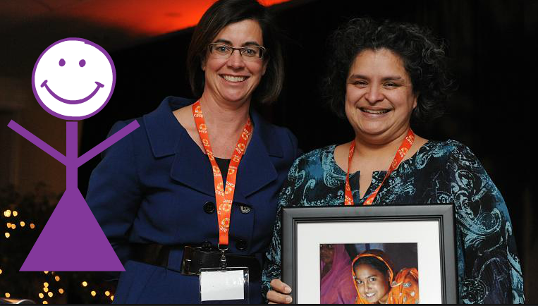
Telling Your Digital Story on Social Media
Start today!
Use hashtag #CARENCC
Reference your social media guide in your conference packet, or access it online at http://ar.gy/socialguide
Today, tweet stories, facts and quotes that inspire you, and accompanying photos and videos.
Today, Sally tweeted quotes that inspired her from keynote speakers. During her issue sessions, she tweeted facts about violence against women that made a strong argument for the need for change. She exchanged contact info with new friends she made, and they connected on social media right away. One of them was even awarded CARE’s “I Am Powerful” award!
Notes:
Place yourself in the scene. Live tweet- description of what this is. You’re somewhere unique, in the middle of the action. Not only do you have a great story to tell people back home, but you can connect both online and off with people who share your passions. Prepare everyone for tomorrow – when you’ll be taking action.

Slide 11
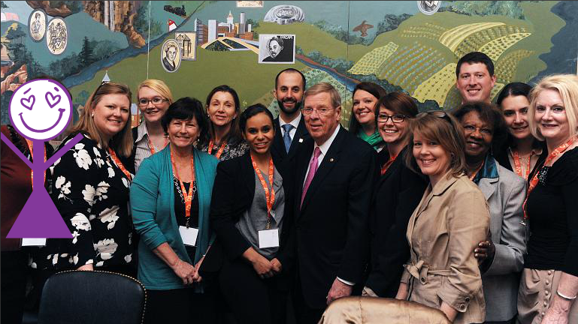
Telling Your Digital Story on Social Media
Tell your lobbying story tomorrow
In kindergarten you learned a good story has a beginning, middle and an end. This is no different.
  Beginning: You’re en route to Capitol Hill! What do you want to accomplish today?
  Middle: You’re at Senator John Doe’s office. What are you asking him to do?
  End: What did John say? If he said yes, tell us what important implications it will have. If he said no or that he needs to consider it, how will you follow up? What will you do to make sure this issue remains an important one in Congress?
On March 6, Sally asked 5 Members of Congress to co-sponsor IVAWA, and three of them said yes! She tweeted about her meetings and posted photos on Facebook and Twitter.
Notes:
-make sure to ask for permission

Slide 12

Telling Your Digital Story on Social Media
Keep the momentum going when you get home
Contact your CARE Action Network representative and read your CARE emails
Raise awareness in your community via social media
Set goals and put a plan into action!
When Sally returned home she shared what she’d learned at the CARE Conference with the women at the shelter. She worked with her CAN rep to hold a panel discussion in her community about the impact of violence against women both in the U.S. and abroad. She kept in touch with all of her NCC friends, and they helped her promote the event.

